Slide 1
GROUP 7 | FET-UB
CrowdSensed
Dynamic Mobile Network Monitoring System
Task 6: Database Design and Implementation
Academic Year 2025/2026 | Faculty of Engineering & Technology | Dept. of Computer Engineering
Submitted: June 2026

Slide 2
Presentation Overview
Mobile App Implementation
Database Implementation
01
04
Real telemetry, TelephonyManager, offline sync
PostgreSQL + PostGIS setup, schema, indexes, live verification
Data Elements
Backend Implementation
02
05
Six categories: users, devices, measurements, operators, reports, coverage
Node.js + Express REST API, endpoints, authentication
Conceptual & ER Design
Live System Demonstration
03
06
Entity relationships and full schema with attributes
Working mobile app connected to live database

Slide 3
2. Mobile Application Implementation
2.1 From Simulated Data → Real Network Telemetry
BEFORE — Simulated Data
AFTER — Real TelephonyManager
• Values generated by JavaScript timers
• Could not represent real coverage
• Simulated data accidentally stored as real
• No meaningful network analysis possible
• Android TelephonyManager integration
• React Native bridge to native Android layer
• Real-time polling via useEffect() lifecycle hook
• Live RSRP, RSRQ, SINR, RSSI, PCI metrics
→
2.2 Android TelephonyManager Integration
RSRP
Coverage quality — reference signal power level
RSRQ
Signal quality relative to interference
SINR
Desired signal vs. noise ratio
RSSI
Total received radio energy
PCI
Physical Cell Identifier
Type
LTE / 5G NR radio technology

Slide 4
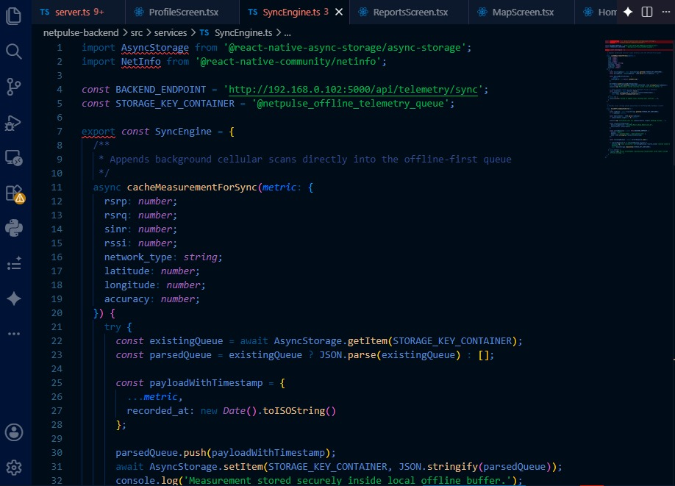
Offline Storage + Backend
Offline-First Telemetry Queue
Fig 15: SyncEngine.ts — cacheMeasurementForSync()
Storage key: @netpulse_offline_telemetry_queue
• Checks connectivity before transmitting
• Queues measurements locally when offline
• Auto-syncs when connection restored
• Payload: timestamp, rsrp, rsrq, rssi, sinr, pci, networkType, lat, lng

Slide 5
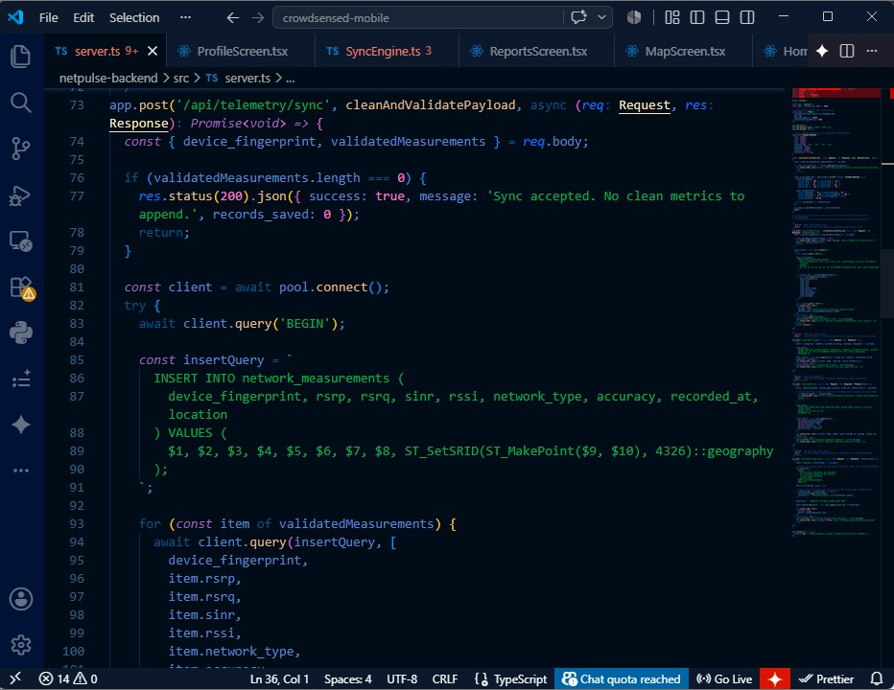
Offline Storage + Backend
Fig 16: server.ts — POST /api/telemetry/sync endpoint
REST API Backend
Node.js + Express | POST /api/telemetry/sync
• Receives & validates telemetry payloads
• Inserts into PostgreSQL with PostGIS geography
• Uses parameterised queries to prevent SQL injection

Slide 6
Data Elements — Six Core Categories
3.1 Users & Auth
3.2 Devices
3.3 Measurements
UUID primary key, username, email
Hashed password (bcrypt)
Role: admin | operator | user
Active flag + timestamps
UUID PK, FK → user
Hardware device identifier
Model, OS version, app version
Last active timestamp
RSRP, RSRQ, SINR, RSSI (dBm/dB)
Network type (LTE/5G)
PostGIS GEOGRAPHY point (WGS84)
Accuracy (m) + sync status
3.4 Network Operators
3.5 Issue Reports
3.6 Coverage & Analytics
Operator name, MCC, MNC
Country reference
Joined to measurements & cells
Links to user + measurement
Issue type, description, location
Status + confidence score
PostGIS GEOGRAPHY polygons
Avg RSRP & SINR per cell
JSONB analytics cache
Sample count + status

Slide 7
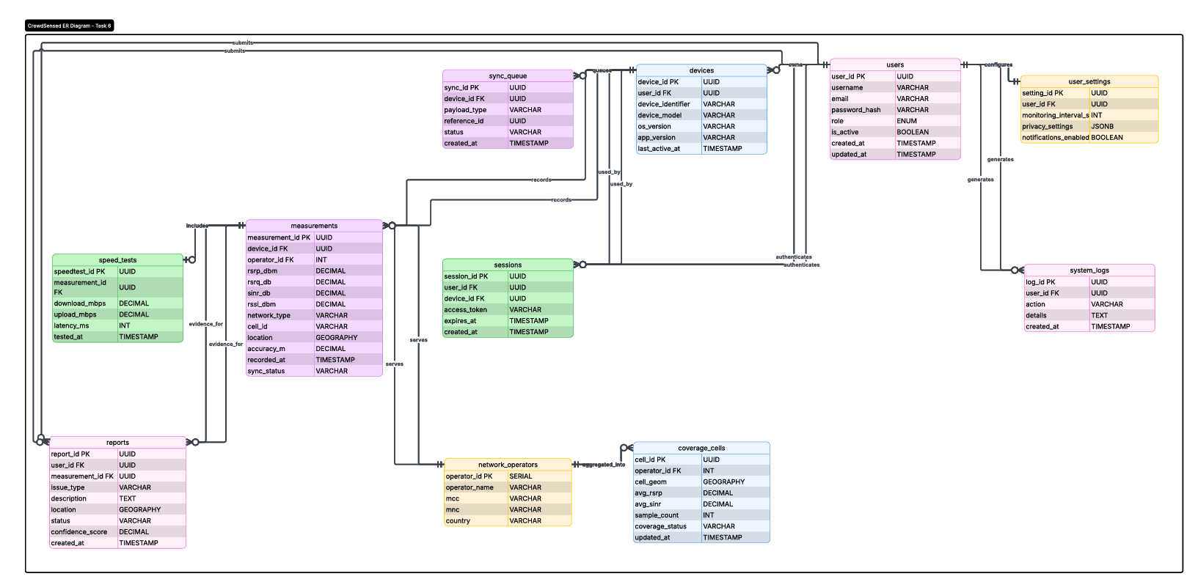
Entity-Relationship (ER) Diagram
users
measurements

Slide 8
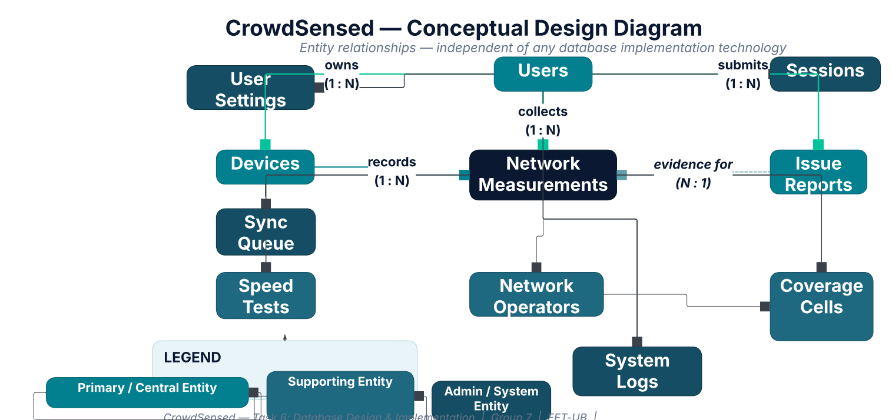
Conceptual Design
users
measurements

Slide 9
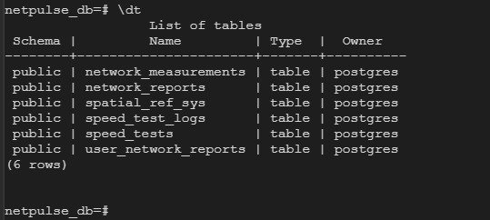
Database Implementation
6.1
PostgreSQL 15 + PostGIS
Fig 17: psql \dt — Live Database Tables
Installed PostgreSQL 15 & PostGIS extension. PostGIS required for GEOGRAPHY column spatial queries.
6.2
Database Role & Extensions
Created dedicated role crowdsensed_user. Enabled postgis, uuid-ossp, pgcrypto extensions.
6.3
schema.sql Execution
Created 7 core tables: network_measurements, network_reports, speed_tests, speed_test_logs, user_network_reports + PostGIS tables.
6.4
Indexes & Seeding
Database Architecture
GIST indexes on GEOGRAPHY columns. B-tree on FK and recorded_at for performance.
PostgreSQL 15 — Core relational engine
6.5
Live Verification (\dt)
PostGIS Extension — Spatial data & GEOGRAPHY type
Confirmed schema on live server via psql \dt — all tables present, PostGIS active (spatial_ref_sys visible).
uuid-ossp — UUID generation for PKs
pgcrypto — Password hashing support

Slide 10
7. Backend Implementation
Project Structure
Fig 16: server.ts — POST /api/telemetry/sync with parameterised INSERT
crowdsensed/
crowdsensed-web/ ← React frontend
crowdsensed-backend/ ← Node.js + Express
netpulse-backend/ ← Mobile API server
REST API Endpoints — /api/v1
POST
/auth/register — Register new user
POST
/auth/login — JWT token authentication
POST
/samples/sync — Receive telemetry measurements
GET
/samples — Retrieve measurements
POST
/reports — Submit issue report
GET
/analytics — Coverage & analytics data
GET
/health — API liveness check

Slide 11
Live System Verification & Summary
Live psql \dt — Deployed netpulse_db
✓ Schema Confirmed on Live Server
✓ network_measurements — core telemetry table
✓ network_reports — user issue reports
✓ speed_tests — download/upload/latency records
✓ speed_test_logs — test audit trail
✓ user_network_reports — reporting views
✓ spatial_ref_sys — PostGIS extension active (6 rows)
Task 6 — Deliverables Completed
Mobile App with real TelephonyManager
Data Elements (6 categories)
Conceptual Design Diagram
ER Diagram (11 tables, full schema)
PostgreSQL + PostGIS Implementation
Node.js + Express REST API
Live System Verification (psql \dt)

Slide 12
8. Connecting Database to Backend
React
Frontend
Axios
api.ts
Node.js +
Express API
PostgreSQL +
PostGIS DB
→
→
→
JWT Bearer token on all requests
Vite proxy: /api → http://localhost:5000
4.1 Wiring the Dashboard to the API
4.2 Live Login Verification
4.3 Real API Traffic Confirmed
api.ts (Axios client) created in crowdsensed-web/src/services/
VITE_API_URL left blank → all requests are relative (e.g. /api/v1/auth/login)
Vite dev proxy forwards /api/* to http://localhost:5000
Request interceptors auto-attach JWT Bearer token
Response interceptors handle 401 → redirect to login
Dashboard started: npm run dev at http://localhost:3000
Two seeded accounts tested:
admin@crowdsensed.cm / admin123 (full admin)
mtn@crowdsensed.cm / operator123 (operator)
POST /api/v1/auth/login returns 200 + token + refreshToken
Backend request log checked after login
Sequence confirmed: POST /auth/login → 200
GET /api/v1/analytics/signal-trends → 200
GET /api/v1/analytics/operator-stats → 304
No mock data — all responses from live PostgreSQL DB
✓ Full stack verified: PostgreSQL → Node.js API → React Dashboard — all serving live data

Slide 13
Thank You
CrowdSensed — Dynamic Mobile Network Monitoring System
Task 6: Database Design & Implementation | Group 7 | FET-UB | 2025/2026

Slide 14
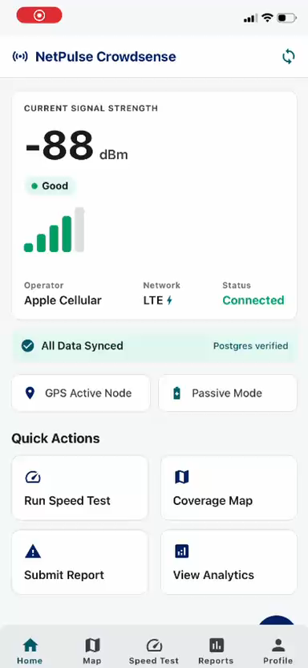
DEMO

